Slide 1
Finding Feshbach resonances, fast
Huan Bui
ZGS Sep 01, 2023

Slide 2
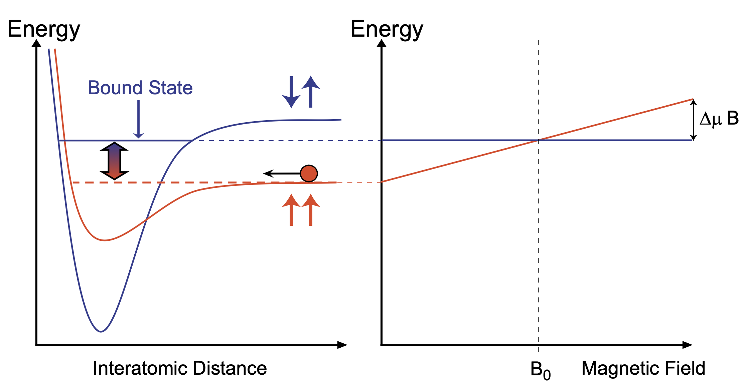
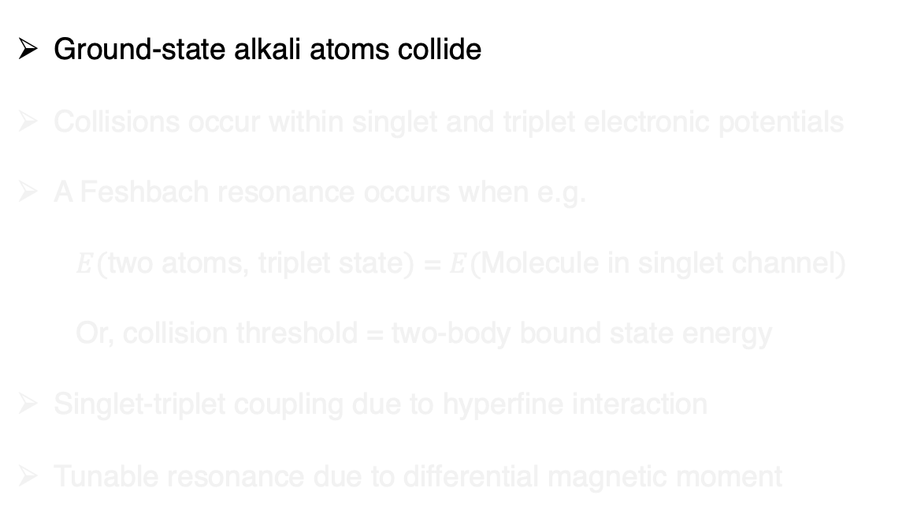
Feshbach resonances revisited
Ground-state alkali atoms collide
Collisions occur within singlet and triplet electronic potentials
A Feshbach resonance occurs when e.g.
$E($two atoms, triplet state$)$ = $E($Molecule in singlet channel$)$
Or, collision threshold = two-body bound state energy
Singlet-triplet coupling due to hyperfine interaction
Tunable resonance due to differential magnetic moment
AMO II S’23, Pset 8

Slide 3
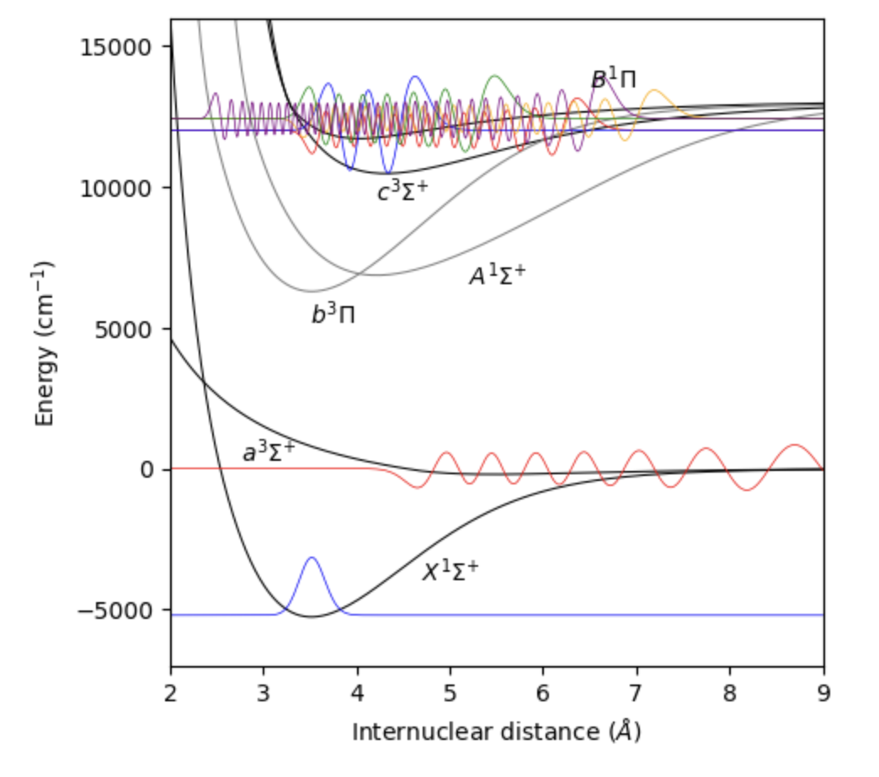
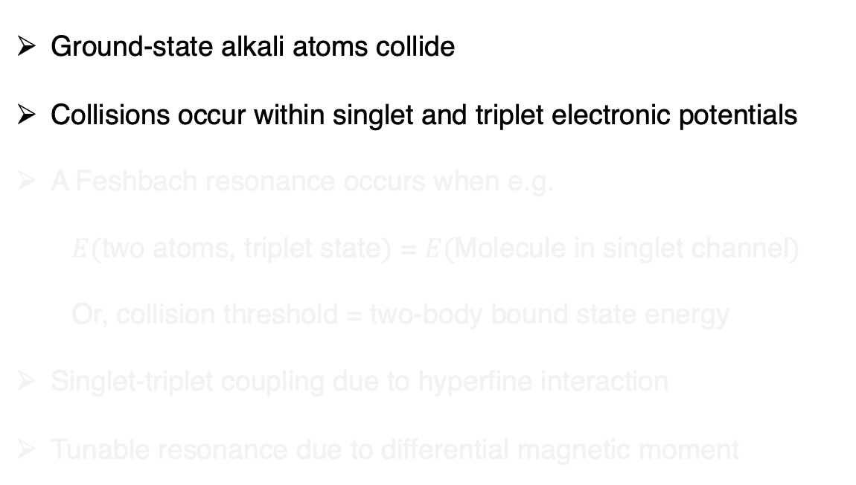
Feshbach resonances revisited
²³Na⁴⁰K
Ground-state alkali atoms collide
Collisions occur within singlet and triplet electronic potentials
A Feshbach resonance occurs when e.g.
$E($two atoms, triplet state$)$ = $E($Molecule in singlet channel$)$
Or, collision threshold = two-body bound state energy
Singlet-triplet coupling due to hyperfine interaction
Tunable resonance due to differential magnetic moment
triplet
singlet
AMO II S’23, Pset 8

Slide 4
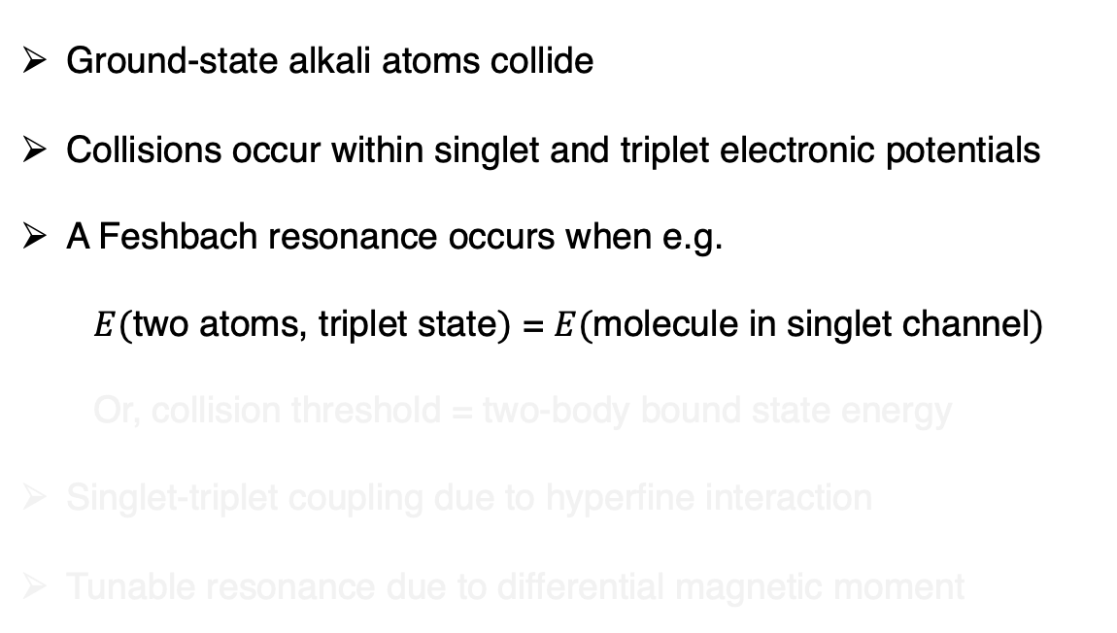
Feshbach resonances revisited
²³Na⁴⁰K
Ground-state alkali atoms collide
Collisions occur within singlet and triplet electronic potentials
A Feshbach resonance occurs when e.g.
$E($two atoms, triplet state$)$ = $E($molecule in singlet channel$)$
Or, collision threshold = two-body bound state energy
Singlet-triplet coupling due to hyperfine interaction
Tunable resonance due to differential magnetic moment
triplet
singlet
AMO II S’23, Pset 8

Slide 5
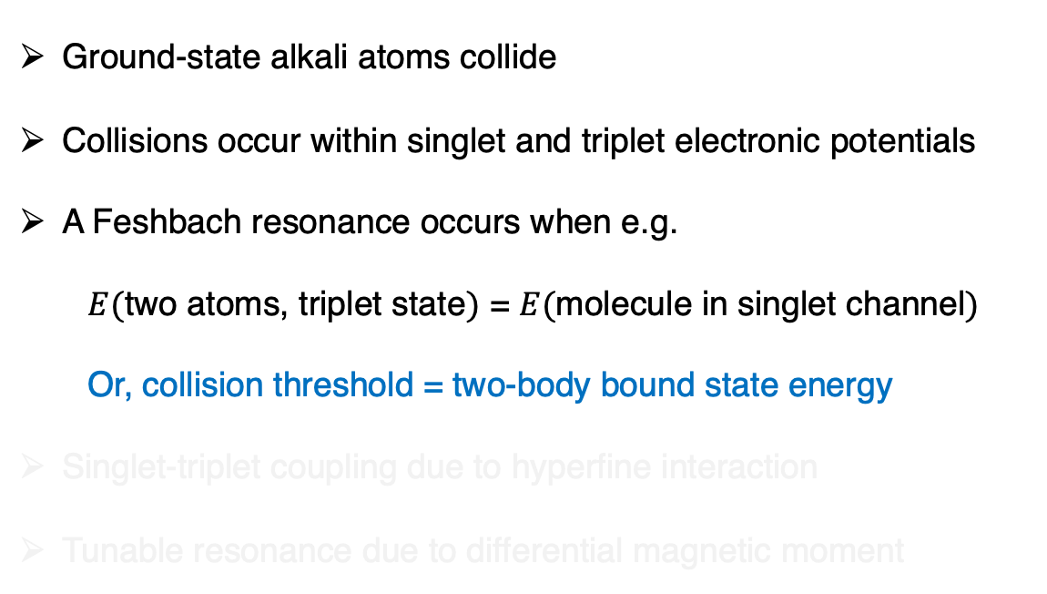
Feshbach resonances revisited
²³Na⁴⁰K
Ground-state alkali atoms collide
Collisions occur within singlet and triplet electronic potentials
A Feshbach resonance occurs when e.g.
$E($two atoms, triplet state$)$ = $E($molecule in singlet channel$)$
Or, collision threshold = two-body bound state energy
Singlet-triplet coupling due to hyperfine interaction
Tunable resonance due to differential magnetic moment
triplet
singlet
AMO II S’23, Pset 8

Slide 6
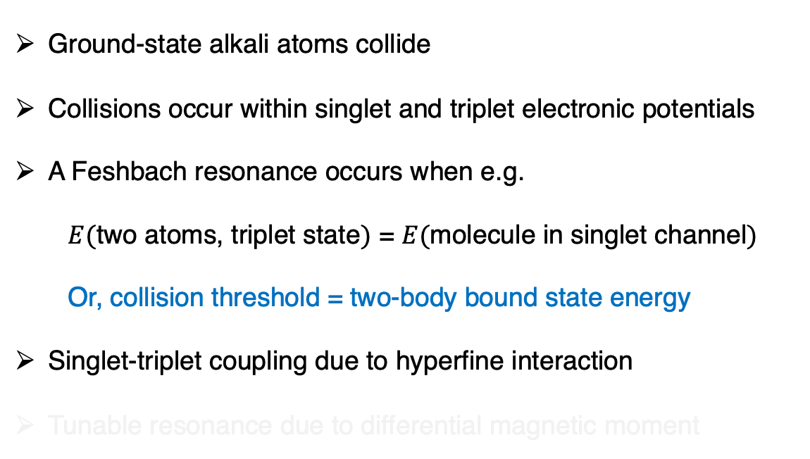
Feshbach resonances revisited
²³Na⁴⁰K
Ground-state alkali atoms collide
Collisions occur within singlet and triplet electronic potentials
A Feshbach resonance occurs when e.g.
$E($two atoms, triplet state$)$ = $E($molecule in singlet channel$)$
Or, collision threshold = two-body bound state energy
Singlet-triplet coupling due to hyperfine interaction
Tunable resonance due to differential magnetic moment
triplet
singlet
AMO II S’23, Pset 8

Slide 7
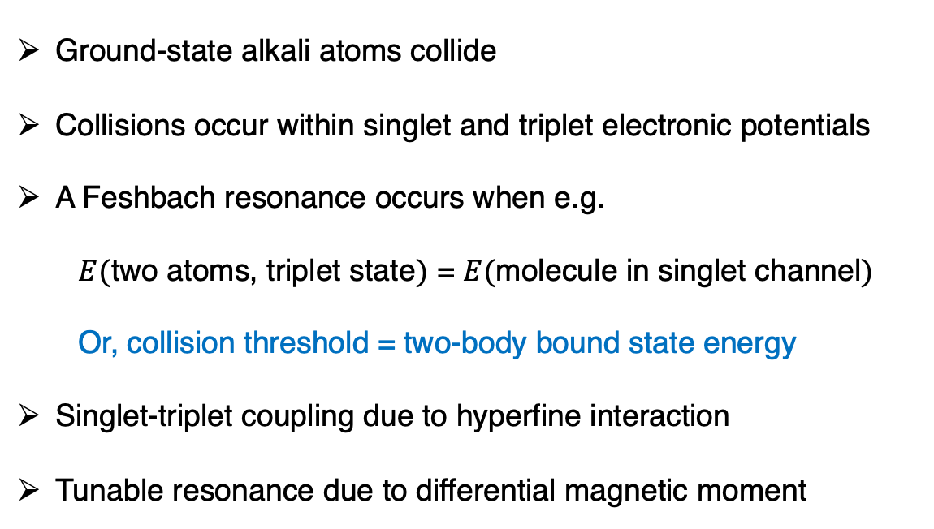
Feshbach resonances revisited
²³Na⁴⁰K
Ground-state alkali atoms collide
Collisions occur within singlet and triplet electronic potentials
A Feshbach resonance occurs when e.g.
$E($two atoms, triplet state$)$ = $E($molecule in singlet channel$)$
Or, collision threshold = two-body bound state energy
Singlet-triplet coupling due to hyperfine interaction
Tunable resonance due to differential magnetic moment
triplet
singlet
AMO II S’23, Pset 8

Slide 8
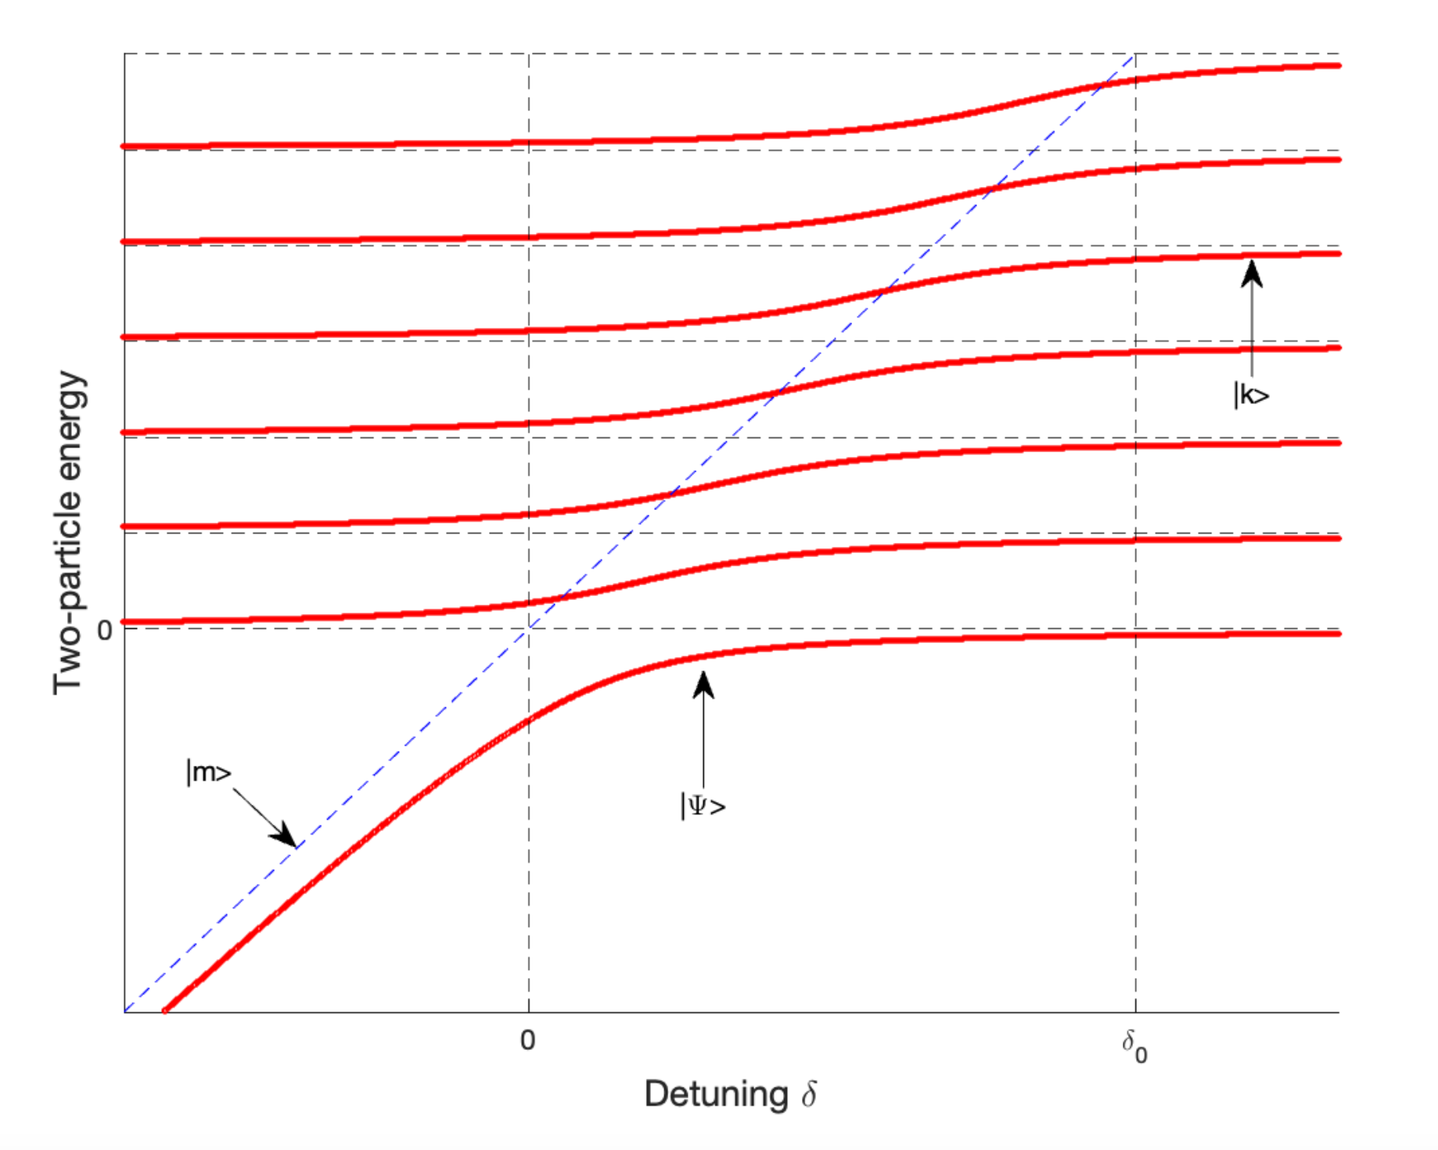
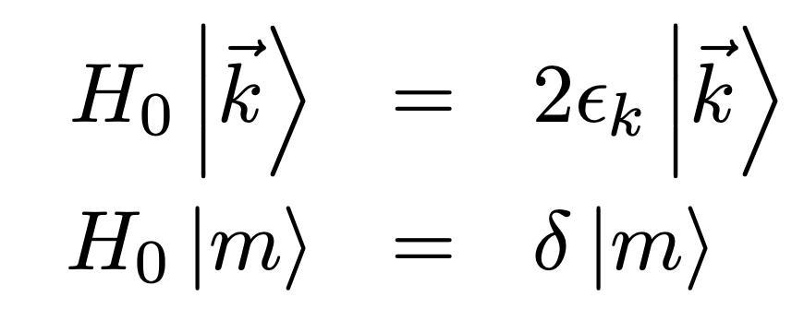
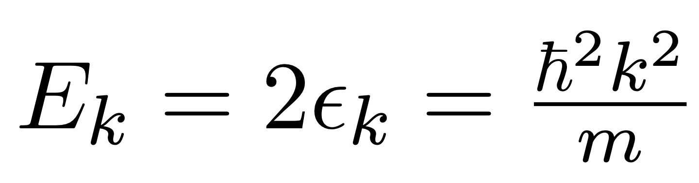
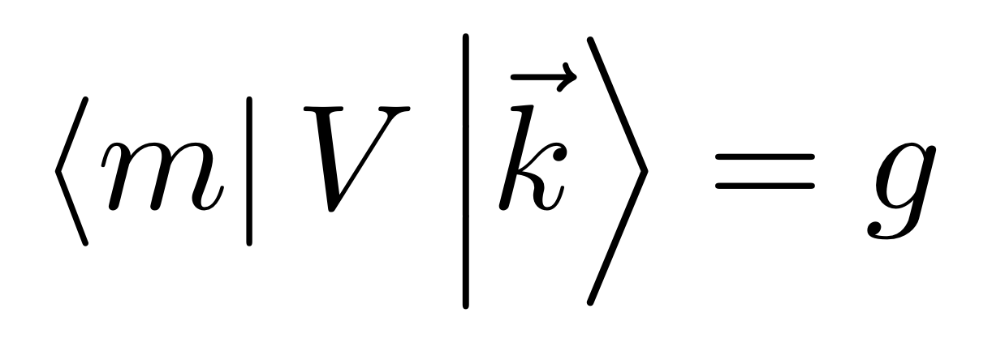
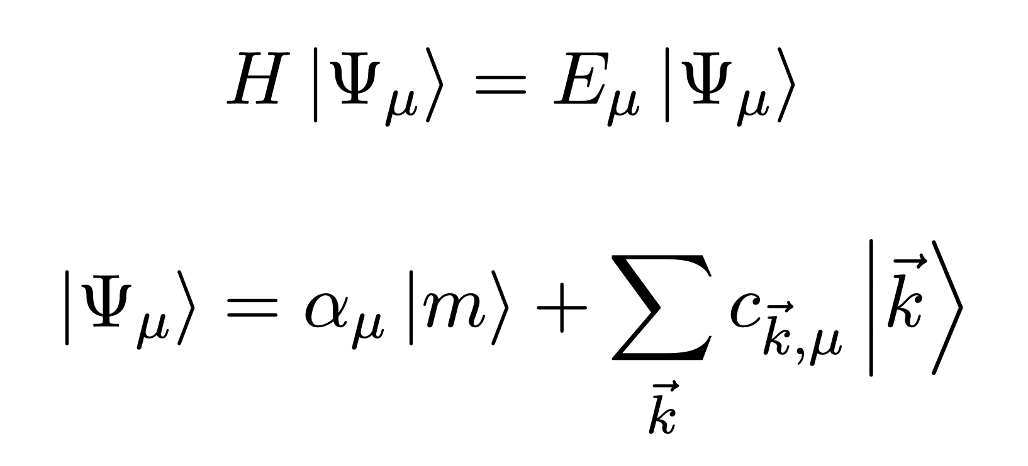
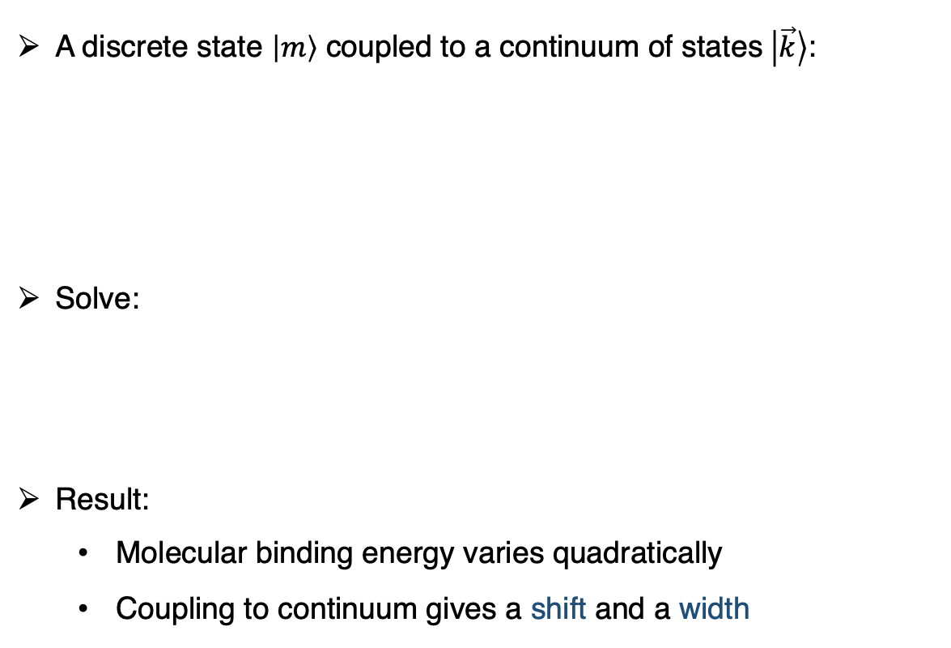
Feshbach resonances: a model from AMO II
A discrete state $\left|m\right\rangle$ coupled to a continuum of states$\left|\vec{k}\right\rangle$:
Solve:
Result:
Molecular binding energy varies quadratically
Coupling to continuum gives a shift and a width
FB resonance

Slide 9
Feshbach resonances: a model from AMO II
A discrete state $\left|m\right\rangle$ coupled to a continuum of states$\left|\vec{k}\right\rangle$:
Solve:
Result:
Molecular binding energy varies quadratically
Coupling to continuum gives a shift and a width
FB resonance

Slide 10
Feshbach resonances: a model from AMO II
A discrete state $\left|m\right\rangle$ coupled to a continuum of states$\left|\vec{k}\right\rangle$:
Solve:
Result:
Molecular binding energy varies quadratically
Coupling to continuum gives a shift and a width
FB resonance

Slide 11

Feshbach resonances: a model from AMO II
A discrete state $\left|m\right\rangle$ coupled to a continuum of states$\left|\vec{k}\right\rangle$:
Solve:
Result:
(Molecular binding energy varies quadratically
Coupling to continuum gives a shift and a width
FB resonance
different pset

Slide 12
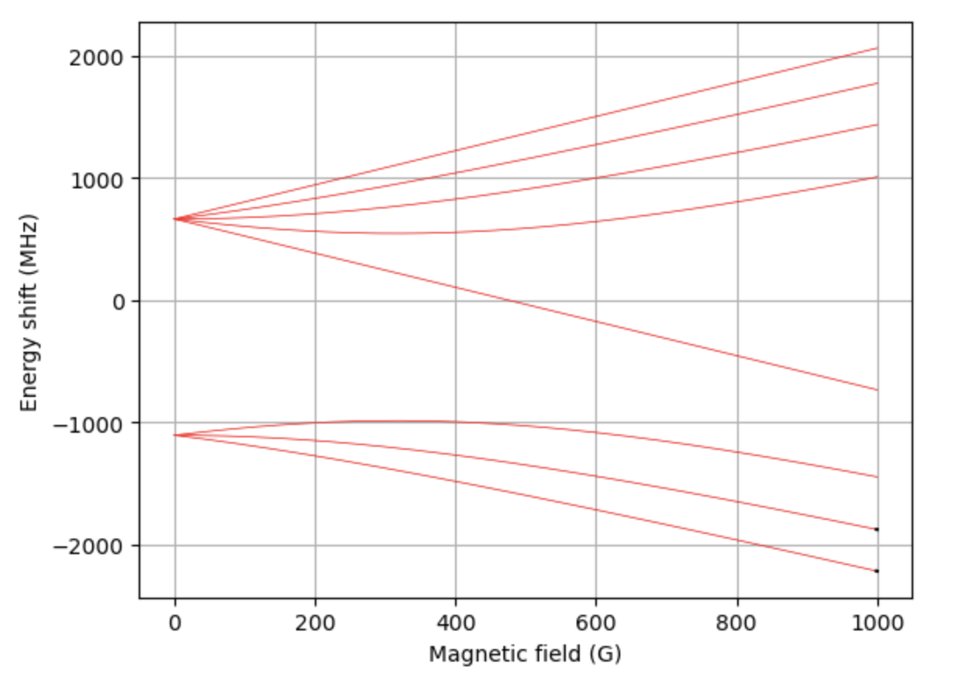
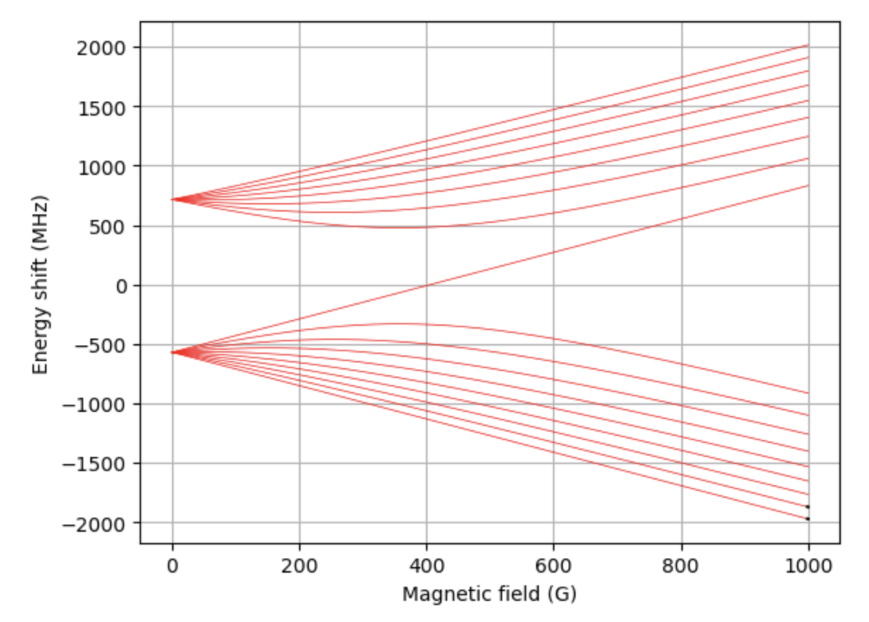
Feshbach resonances: the reality
Scenario: Find FB resonances in e.g. ²³Na⁴⁰K, ⁶Li⁴⁰K, or ⁶Li₂ from spectroscopic data
Problem:
Find Feshbach resonances & widths
Find binding energies, spin character of FB molecules,…
Solution: Calculate, then measure. Two existing methods:
Coupled-channel calculation
Asymptotic bound-state model

Slide 13
Feshbach resonances: the reality
Scenario: Find FB resonances in e.g. ²³Na⁴⁰K, ⁶Li⁴⁰K, or ⁶Li₂ from spectroscopic data
Problem:
Find Feshbach resonances & widths
Find binding energies, spin character of FB molecules,…
Solution: Calculate, then measure. Two existing methods:
Coupled-channel calculation
Asymptotic bound-state model

Slide 14
Feshbach resonances: the reality
Scenario: Find FB resonances in e.g. ²³Na⁴⁰K, ⁶Li⁴⁰K, or ⁶Li₂ from spectroscopic data
Problem:
Find Feshbach resonances & widths
Find binding energies, spin character of FB molecules,…
Solution: Calculate, then measure. Three existing methods:
Coupled-channel calculation
Asymptotic bound-state model
“Kindly ask a theorist to do the job” – BZO (2023)

Slide 15
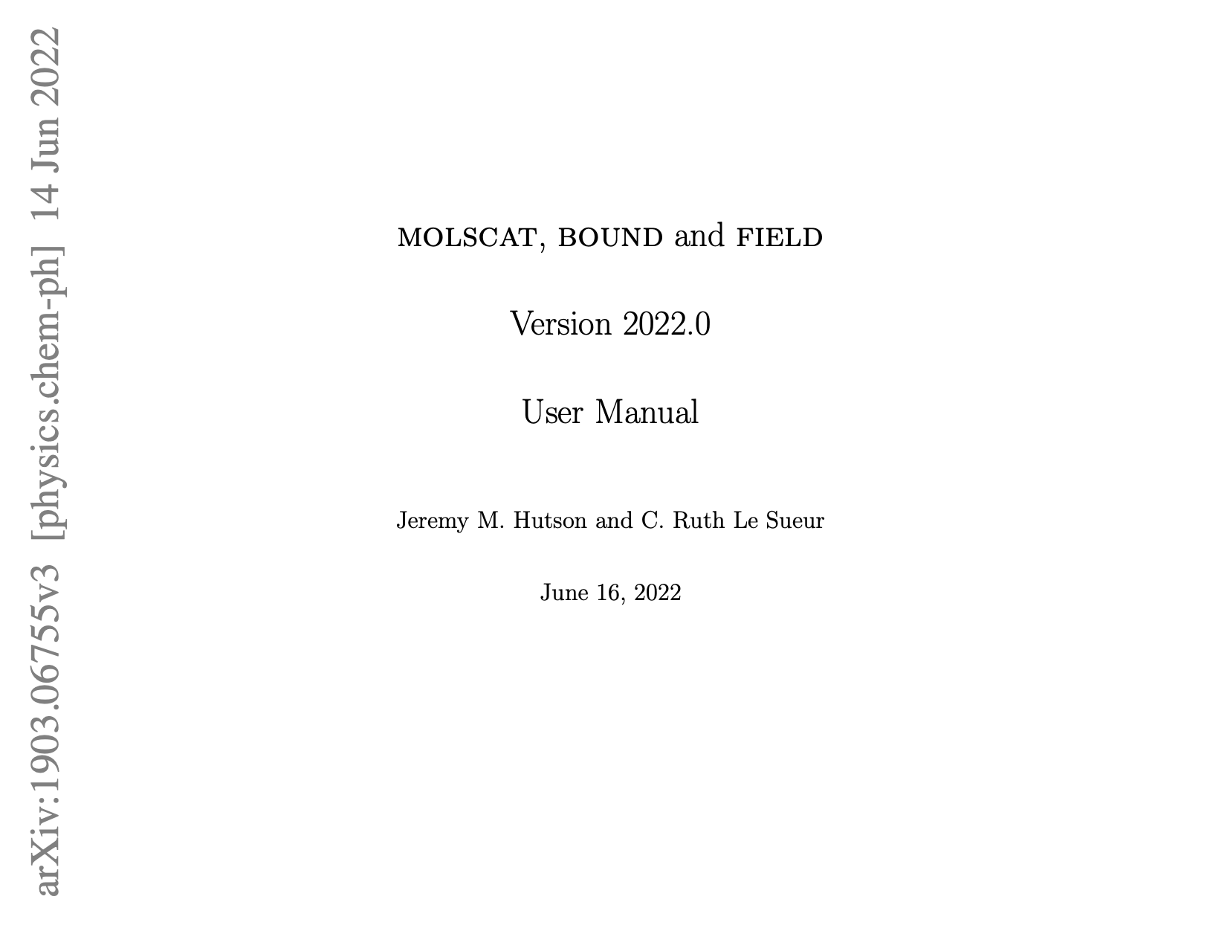
Coupled-channel calculations (CC) [1]
Interactions have spin + orbital degrees of freedom
Resulting in coupled radial SE’s in spin basis
Numerically solve for scattering properties + bound states
Dedicated program by J. M. Hutson & C. R. L. Sueur
3 Fortran programs (code available on Github here):
MOLSCAT (arXiv), BOUND & FIELD (arXiv)
Drawbacks:
Interaction potentials typically not accurate enough
Many degrees of freedom → time consuming
Numerical issues (grid size & numerical accuracy)
Not easy to learn how to use and implement!
210-page user manual

Slide 16
Coupled-channel calculations (CC) [1]
Interactions have spin + orbital degrees of freedom
Resulting in coupled radial SE’s in spin basis
Numerically solve for scattering properties + bound states
Dedicated program by J. M. Hutson & C. R. L. Sueur
3 Fortran programs (code available on Github here):
MOLSCAT (arXiv), BOUND & FIELD (arXiv)
Drawbacks:
Interaction potentials typically not accurate enough
Many degrees of freedom → time consuming
Numerical issues (grid size & numerical accuracy)
Not easy to learn how to use and implement!
210-page user manual

Slide 17
Coupled-channel calculations (CC) [1]
Interactions have spin + orbital degrees of freedom
Resulting in coupled radial SE’s in spin basis
Numerically solve for scattering properties + bound states
Dedicated program by J. M. Hutson & C. R. L. Sueur
3 Fortran programs (code available on Github here):
MOLSCAT (arXiv), BOUND & FIELD (arXiv)
Drawbacks:
Interaction potentials typically not accurate enough (GIGO)
Many degrees of freedom → time consuming
Numerical issues (grid size & numerical accuracy)
Not easy to learn how to use and implement!
210-page user manual

Slide 18
Coupled-channel calculations (CC) [1]
Interactions have spin + orbital degrees of freedom
Resulting in coupled radial SE’s in spin basis
Numerically solve for scattering properties + bound states
Dedicated program by J. M. Hutson & C. R. L. Sueur
3 Fortran programs (code available on Github here):
MOLSCAT (arXiv), BOUND & FIELD (arXiv)
Drawbacks:
Interaction potentials typically not accurate enough (GIGO)
Many degrees of freedom → time consuming
Numerical issues (grid size & numerical accuracy)
Not easy to learn how to use and implement!
210-page user manual

Slide 19
Asymptotic Bound-state Model (ABM)
Tobias Tiecke et al (Phys. Rev. A 82, 042712)

Slide 20
Asymptotic Bound-state Model (ABM)
Tobias Tiecke et al (Phys. Rev. A 82, 042712)
Model description
Obtaining input parameters
Implementation (examples)
Comments

Slide 21
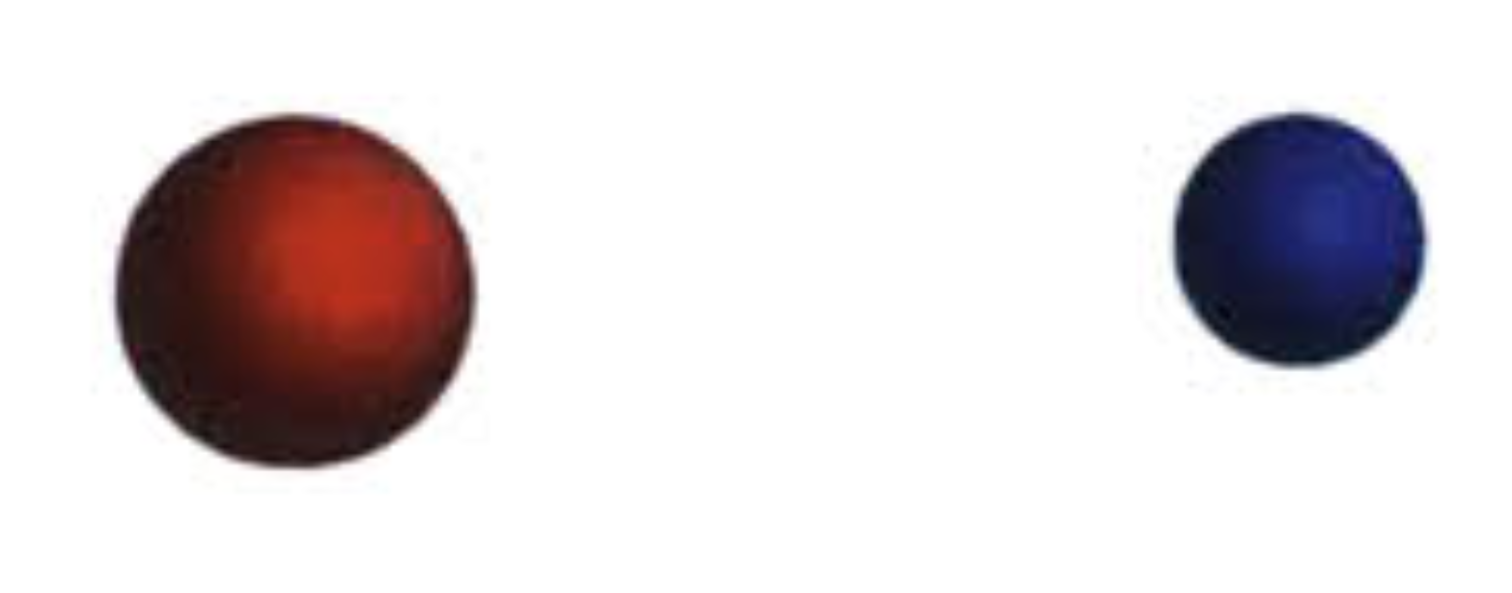
ABM description: Setup
Two atoms A and B in their electronic ground state

Slide 22
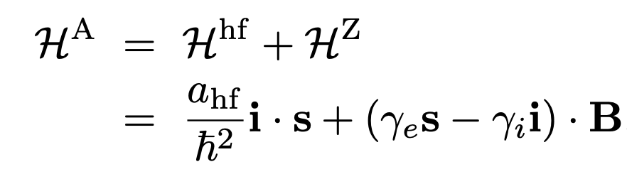
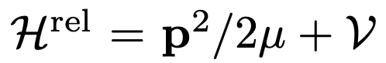
ABM description: Setup
Two atoms A and B in their electronic ground state
Hamiltonian = Relative motion in COM frame + Internal energy
+ atom β
You may already have this part on your laptop!

Slide 23
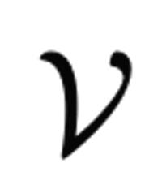
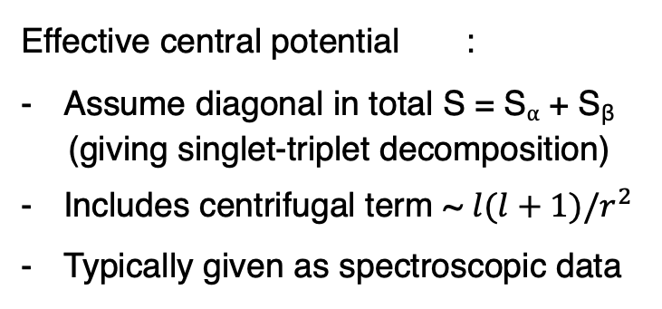
ABM description: Setup
Two atoms A and B in their electronic ground state
Hamiltonian = Relative motion in COM frame + Internal energy
+ atom β
Effective central potential :
Assume diagonal in total S = S⍺ + S_{β}
(giving singlet-triplet decomposition)
Includes centrifugal term ~ $l(l+1)/r^{2}$
Typically given as spectroscopic data
You may already have this part on your laptop!

Slide 24
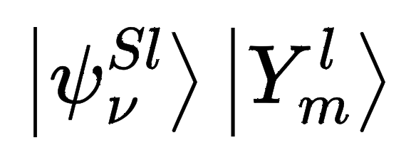
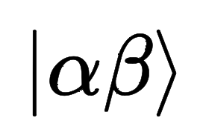
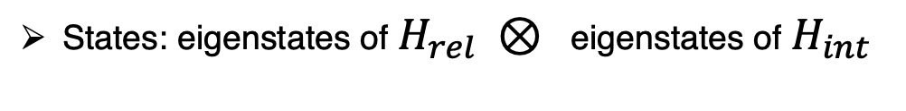
ABM description: Setup
Two atoms ⍺ and β in their electronic ground state
Hamiltonian = Relative motion in COM frame + Internal energy
+ atom β
Effective central potential :
Assume diagonal in total S = S⍺ + S_{β}
(giving singlet-triplet decomposition)
Includes centrifugal term ~ $l(l+1)/r^{2}$
Typically given as spectroscopic data
You may already have this part on your laptop!
States: eigenstates of $H_{rel} ⊗$ eigenstates of $H_{int}$

Slide 25
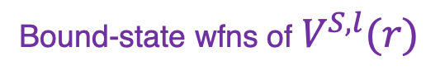
ABM description: Setup
Two atoms ⍺ and β in their electronic ground state
Hamiltonian = Relative motion in COM frame + Internal energy
+ atom β
Effective central potential :
Assume diagonal in total S = S⍺ + S_{β}
(giving singlet-triplet decomposition)
Includes centrifugal term ~ $l(l+1)/r^{2}$
Typically given as spectroscopic data
You may already have this part on your laptop!
States: eigenstates of $H_{rel} ⊗$ eigenstates of $H_{int}$
Bound-state wfns of $V^{S,l}(r)$
Breit-Rabi basis

Slide 26
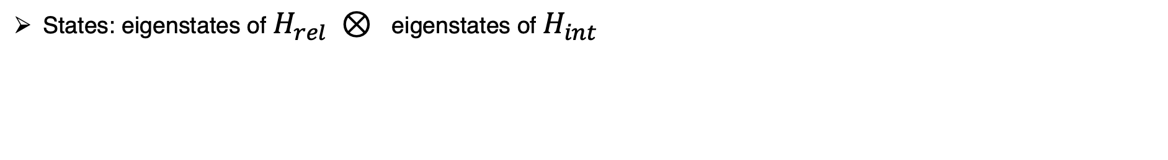
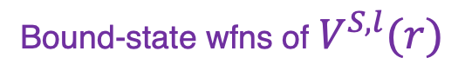
ABM description: Basis states
States: eigenstates of $H_{rel} ⊗$ eigenstates of $H_{int}$
Bound-state wfns of $V^{S,l}(r)$
Breit-Rabi basis

Slide 27
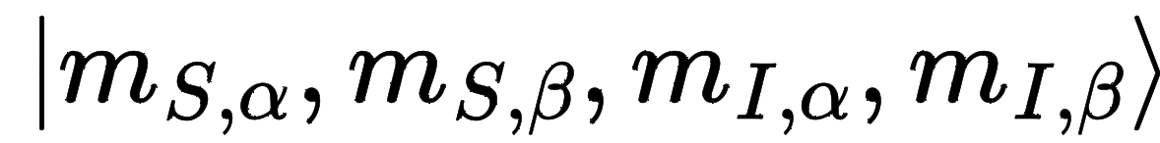
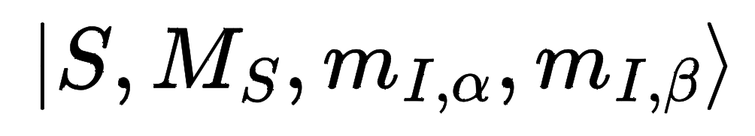
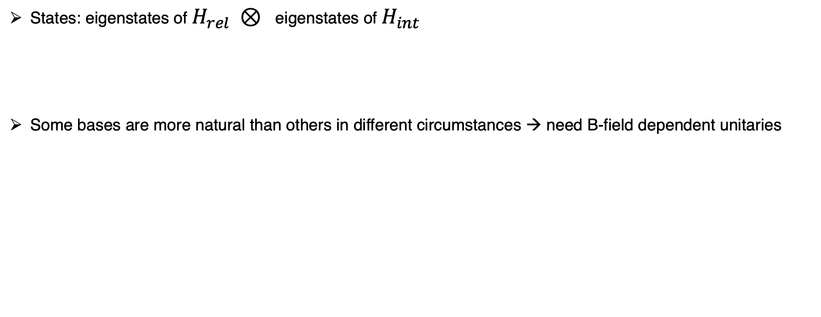
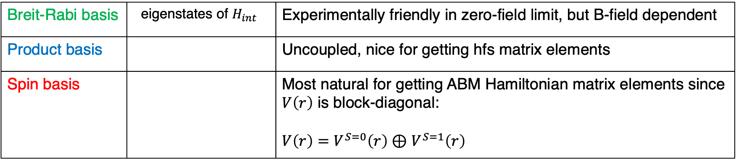
ABM description: Basis states
States: eigenstates of $H_{rel} ⊗$ eigenstates of $H_{int}$
Some bases are more natural than others in different circumstances → need B-field dependent unitaries
Bound-state wfns of $V^{S,l}(r)$
Breit-Rabi basis
Breit-Rabi basis | eigenstates of $H_{int}$ | Experimentally friendly in zero-field limit, but B-field dependent
Product basis |  | Uncoupled, nice for getting hfs matrix elements
Spin basis |  | Most natural for getting ABM Hamiltonian matrix elements since $V\left(r\right)$ is block-diagonal: $V\left(r\right)=V^{S=0}\left(r\right)⊕$ $V^{S=1}\left(r\right)$

Slide 28
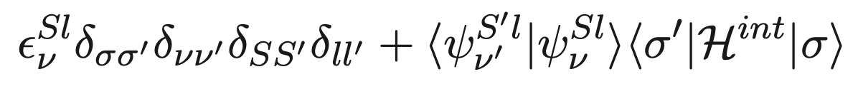
ABM description: Hamiltonian matrix elements
In ABM spin basis:
Spin degree of freedom
Binding energy of
Relative motion Hamiltonian
is diagonal in spin basis
Franck-Condon factor

Slide 29
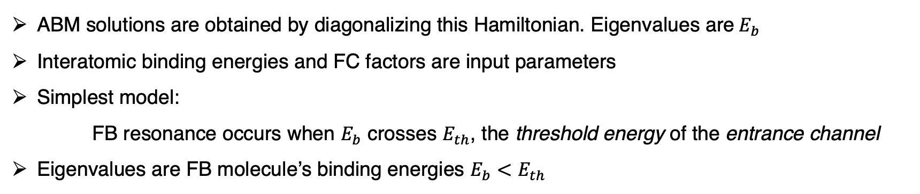
ABM description: Hamiltonian matrix elements
In ABM spin basis:
Spin degree of freedom
Binding energy of
Relative motion Hamiltonian
is diagonal in spin basis
Franck-Condon factor
ABM solutions are obtained by diagonalizing this Hamiltonian. Eigenvalues are$E_{b}$
Interatomic binding energies and FC factors are input parameters
Simplest model:
FB resonance occurs when $E_{b}$ crosses $E_{th}$, the threshold energy of the entrance channel
Eigenvalues are FB molecule’s binding energies $E_{b}<E_{th}$

Slide 30
ABM description: Some definitions
Entrance channel:
Experimentally, entrance channel is an eigenstate of internal Hamiltonian
e.g. ²³Na⁴⁰K Feshbach molecules of type Na(1,1) + K(9/2,-9/2)*
Entrance channel is one of the Breit-Rabi basis states
(*) in zero-field limit

Slide 31
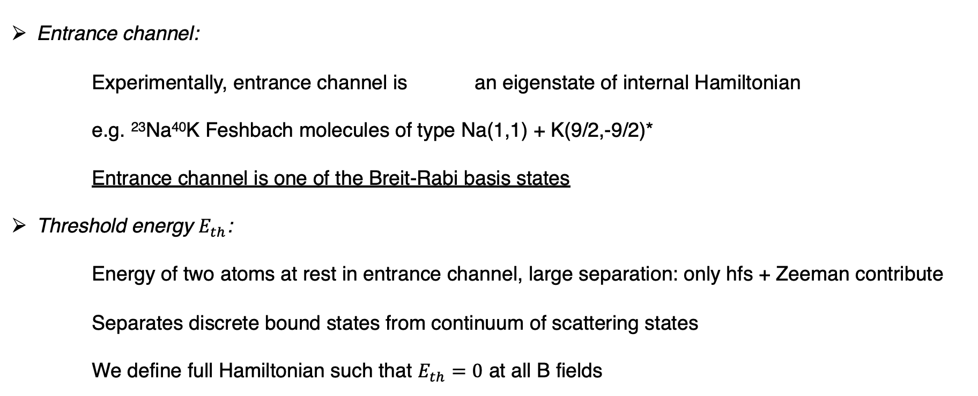
ABM description: Some definitions
Entrance channel:
Experimentally, entrance channel is an eigenstate of internal Hamiltonian
e.g. ²³Na⁴⁰K Feshbach molecules of type Na(1,1) + K(9/2,-9/2)*
Entrance channel is one of the Breit-Rabi basis states
Threshold energy $E_{th}$:
Energy of two atoms at rest in entrance channel, large separation: only hfs + Zeeman contribute
Separates discrete bound states from continuum of scattering states
We define full Hamiltonian such that $E_{th}=0$ at all B fields
(*) in zero-field limit

Slide 32
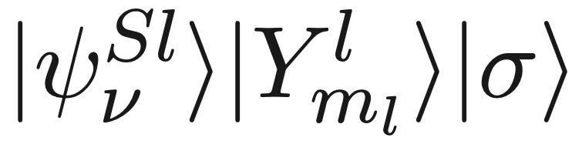
ABM description: assumptions/simplifications
ABM works with a small, discrete set of states
Assumption: hfs couplings << rovibrational level spacings
If met, then least-bound states (or asymptotically bound states) suffice
Can estimate FC factors + binding energies based on long-range behavior of interatomic potential

Slide 33
ABM description: assumptions/simplifications
ABM works with a small, discrete set of states
Assumption: hfs couplings << rovibrational level spacings
If met, then least-bound states (or asymptotically bound states) suffice
Can estimate FC factors + binding energies based on long-range behavior of interatomic potential
No solving of radial SE equation → Humongous simplification over CCC

Slide 34
ABM description: assumptions/simplifications
ABM works with a small, discrete set of states
Assumption: hfs couplings << rovibrational level spacings
If met, then least-bound states (or asymptotically bound states) suffice
Can estimate FC factors + binding energies based on long-range behavior of interatomic potential
No solving of radial SE equation → Humongous simplification over CCC
No continuum involved (in simplest case)

Slide 35
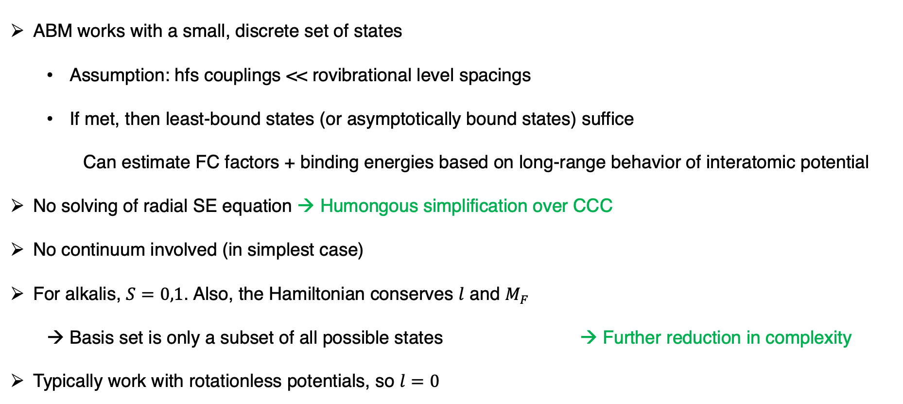
ABM description: assumptions/simplifications
ABM works with a small, discrete set of states
Assumption: hfs couplings << rovibrational level spacings
If met, then least-bound states (or asymptotically bound states) suffice
Can estimate FC factors + binding energies based on long-range behavior of interatomic potential
No solving of radial SE equation → Humongous simplification over CCC
No continuum involved (in simplest case)
For alkalis, $S=0,1$. Also, the Hamiltonian conserves $l$ and $M_{F}$
Basis set is only a subset of all possible states → Further reduction in complexity
Typically work with rotationless potentials, so $l=0$

Slide 36

Recap so far…
Model description
Obtaining input parameters
Implementation (examples)
Comments
Basis states
Hamiltonian
Rule for getting Hamiltonian matrix elements

Slide 37
Recap so far…
Model description
Obtaining input parameters
Implementation (examples)
Comments
Basis states
Hamiltonian
Rule for getting Hamiltonian matrix elements
???
We need input parameters

Slide 38
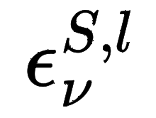
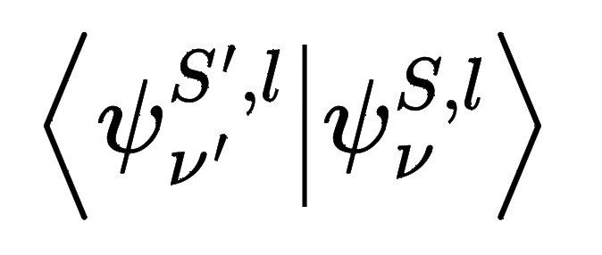
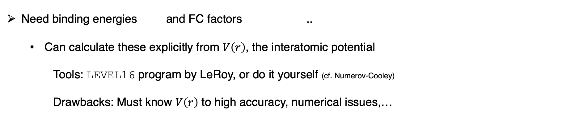
Obtaining input parameters for ABM
Need binding energies and FC factors ..
Can calculate these explicitly from $V\left(r\right)$, the interatomic potential
Tools: LEVEL16 program by LeRoy, or do it yourself (cf. Numerov-Cooley)
Drawbacks: Must know $V\left(r\right)$ to high accuracy, numerical issues,…

Slide 39
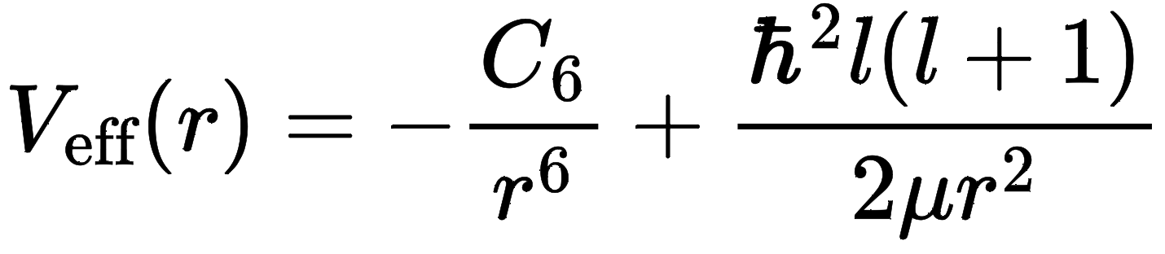
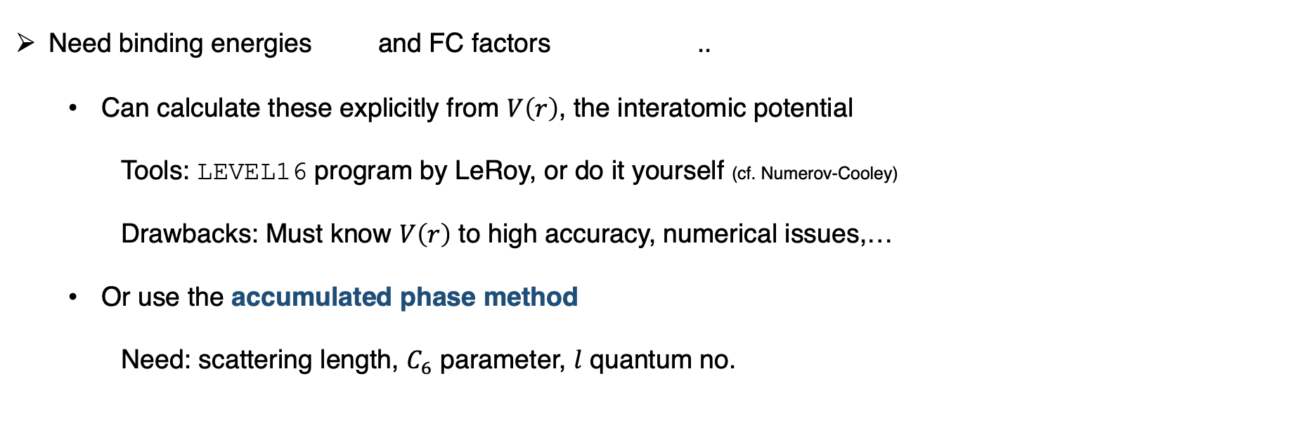
Obtaining input parameters for ABM
Need binding energies and FC factors ..
Can calculate these explicitly from $V\left(r\right)$, the interatomic potential
Tools: LEVEL16 program by LeRoy, or do it yourself (cf. Numerov-Cooley)
Drawbacks: Must know $V\left(r\right)$ to high accuracy, numerical issues,…
Or use the accumulated phase method
Need: scattering length, $C_{6}$ parameter, $l$ quantum no.

Slide 40
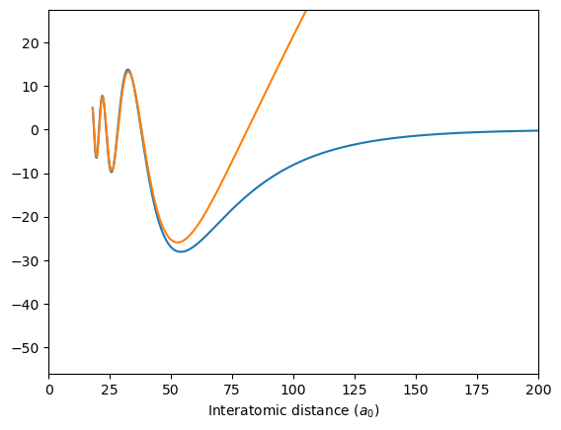
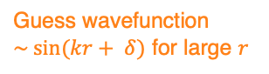
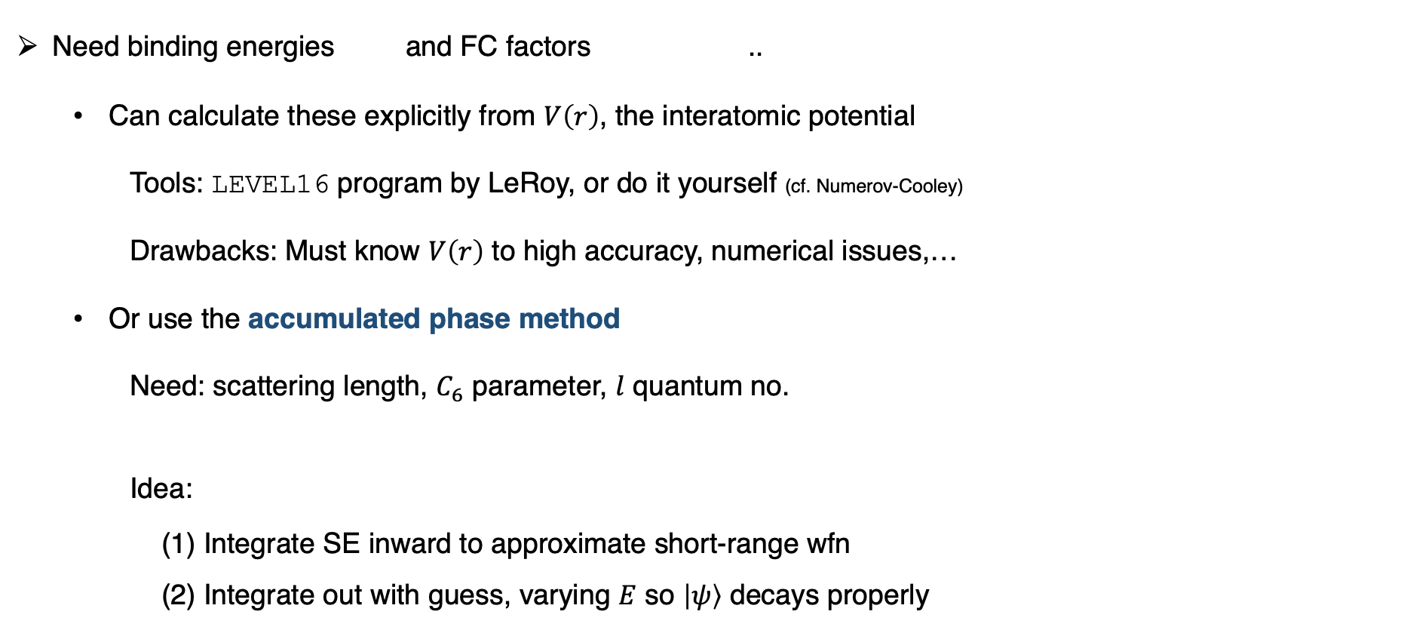
Obtaining input parameters for ABM
Need binding energies and FC factors ..
Can calculate these explicitly from $V\left(r\right)$, the interatomic potential
Tools: LEVEL16 program by LeRoy, or do it yourself (cf. Numerov-Cooley)
Drawbacks: Must know $V\left(r\right)$ to high accuracy, numerical issues,…
Or use the accumulated phase method
Need: scattering length, $C_{6}$ parameter, $l$ quantum no.
Idea:
(1) Integrate SE inward to approximate short-range wfn
(2) Integrate out with guess, varying $E$ so $\left|ψ\right\rangle$ decays properly
Guess wavefunction
$\sim sin(kr+ δ)$ for large $r$
Least-bound state of Na⁴⁰K X¹Σ⁺

Slide 41
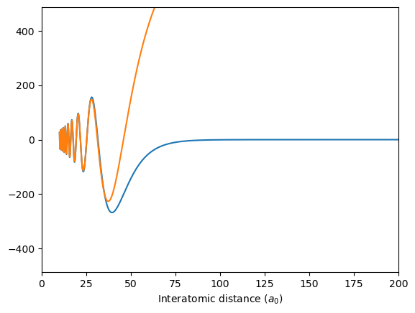
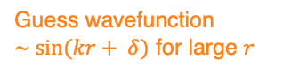
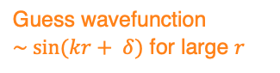
Obtaining input parameters for ABM
Example: ²³Na⁴⁰K
Guess wavefunction
$\sim sin(kr+ δ)$ for large $r$
Guess wavefunction
$\sim sin(kr+ δ)$ for large $r$
Least-bound state of Na⁴⁰K X¹Σ⁺
Least-bound state of Na⁴⁰K a³Σ⁺
150 MHz binding energy
1650 MHz binding energy

Slide 42
Obtaining input parameters for ABM
Example: ²³Na⁴⁰K
Guess wavefunction
$\sim sin(kr+ δ)$ for large $r$
Guess wavefunction
$\sim sin(kr+ δ)$ for large $r$
FC factor = 0.5
Can be found from wfn’s or
exponential asymptotic form
Least-bound state of Na⁴⁰K X¹Σ⁺
Least-bound state of Na⁴⁰K a³Σ⁺
150 MHz binding energy
1650 MHz binding energy

Slide 43
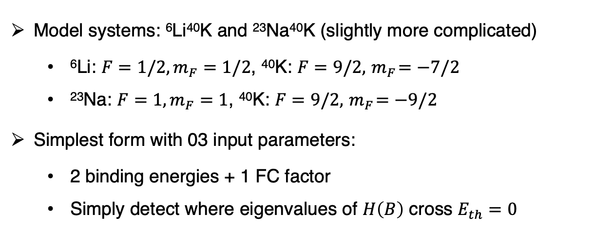
Implementation
Model description
Obtaining input parameters
Implementation (examples)
Comments
Model systems: ⁶Li⁴⁰K and ²³Na⁴⁰K (slightly more complicated)
⁶Li: $F=1/2,m_{F}=1/2$, ⁴⁰K: $F=9/2,{ m}_{F}=−7/2$
²³Na: $F=1, m_{F}=1$, ⁴⁰K: $F=9/2,{ m}_{F}=−9/2$
Simplest form with 03 input parameters:
2 binding energies + 1 FC factor
Simply detect where eigenvalues of $H\left(B\right)$ cross $E_{th}=0$

Slide 44
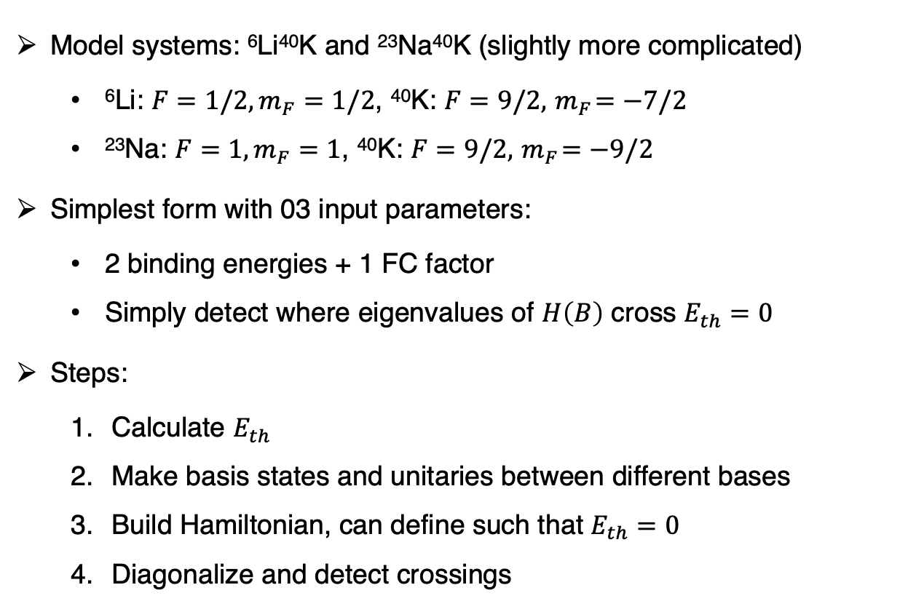
Implementation
Model description
Obtaining input parameters
Implementation (examples)
Comments
Model systems: ⁶Li⁴⁰K and ²³Na⁴⁰K (slightly more complicated)
⁶Li: $F=1/2,m_{F}=1/2$, ⁴⁰K: $F=9/2,{ m}_{F}=−7/2$
²³Na: $F=1, m_{F}=1$, ⁴⁰K: $F=9/2,{ m}_{F}=−9/2$
Simplest form with 03 input parameters:
2 binding energies + 1 FC factor
Simply detect where eigenvalues of $H\left(B\right)$ cross $E_{th}=0$
Steps:
Calculate $E_{th}$
Make basis states and unitaries between different bases
Build Hamiltonian, can define such that $E_{th}=0$
Diagonalize and detect crossings

Slide 45
Implementation
Model description
Obtaining input parameters
Implementation (examples)
Comments
Model systems: ⁶Li⁴⁰K and ²³Na⁴⁰K (slightly more complicated)
⁶Li: $F=1/2,m_{F}=1/2$, ⁴⁰K: $F=9/2,{ m}_{F}=−7/2$
²³Na: $F=1, m_{F}=1$, ⁴⁰K: $F=9/2,{ m}_{F}=−9/2$
Simplest form with 03 input parameters:
2 binding energies + 1 FC factor
Simply detect where eigenvalues of $H\left(B\right)$ cross $E_{th}=0$
Steps:
Calculate $E_{th}$
Make basis states and unitaries between different bases
Build Hamiltonian, can define such that $E_{th}=0$
Diagonalize and detect crossings
Standard ABM

Slide 46

Implementation: Standard ABM
Calculate $E_{th}$: just add the hfs + Zeeman energies from each atom
Make basis states and unitaries between different bases
Build Hamiltonian, can define such that $E_{th}=0$
Diagonalize and detect crossings

Slide 47




Implementation: Standard ABM
Calculate $E_{th}$: just add the hfs + Zeeman energies from each atom
Make basis states and unitaries between different bases
Build Hamiltonian, can define such that $E_{th}=0$
Diagonalize and detect crossings
²³Na⁴⁰K
²³Na: $F=1, m_{F}=1$
+
⁴⁰K: $F=9/2,{ m}_{F}=−9/2$

Slide 48

Implementation: Standard ABM
Calculate $E_{th}$
Make basis states and unitaries between different bases
Build Hamiltonian, can define such that $E_{th}=0$
Diagonalize and detect crossings

Slide 49


Implementation: Standard ABM
Calculate $E_{th}$
Make basis states and unitaries between different bases
Build Hamiltonian, can define such that $E_{th}=0$
Diagonalize and detect crossings
Standard ABM:
Only need spin basis & product basis
Unitaries are Clebsch-Gordan matrices, no B-field dependence
Only need basis states with the same $M_{F}$as entrance channel → smaller Hilbert space!
 | ⁶Li ($1/2, 1/2)$, ⁴⁰K ($9/2, −7/2)$ | ²³Na $(1, 1)$, ⁴⁰K ($9/2, −9/2)$
Full basis | 108 states | 144 states
Reduced, constant $M_{F}$ basis | 11 states | 12 states

Slide 50

Implementation: Standard ABM
Calculate $E_{th}$
Make basis states and unitaries between different bases
Build Hamiltonian, can define such that $E_{th}=0$
Diagonalize and detect crossings

Slide 51
Implementation: Standard ABM
Calculate $E_{th}$
Make basis states and unitaries between different bases
Build Hamiltonian, can define such that $E_{th}=0$
Diagonalize and detect crossings
calculate in product basis,
then transform to spin basis
In ABM spin basis:
Binding energy of
Relative motion Hamiltonian
is diagonal in spin basis
Franck-Condon factor

Slide 52

Implementation: Standard ABM
Calculate $E_{th}$
Make basis states and unitaries between different bases
Build Hamiltonian, can define such that $E_{th}=0$
Diagonalize and detect crossings

Slide 53


Implementation: Standard ABM
Calculate $E_{th}$
Make basis states and unitaries between different bases
Build Hamiltonian, can define such that $E_{th}=0$
Diagonalize and detect crossings
⁶Li(1)⁴⁰K(2)
²³Na(1)⁴⁰K(1)
Crossings: 149 G, 154 G, 164 G
E threshold
Crossings: 74 G, 79 G
Measured: 149.2 G, 159.5 G, 165.9 G [2]
Measured: 78.3 G, 88.2 [3]

Slide 54

Implementation: Standard ABM
Standard ABM predicts FB resonances with reasonable accuracy, but not fantastic
Works better for ⁶Li⁴⁰K but not ²³Na⁴⁰K
Why? ²³Na⁴⁰K has large, negative background scattering length ($a_{bg}≈−690a_{0}≫r_{0}$) [7]

Slide 55

Implementation: Standard ABM
Standard ABM predicts FB resonances with reasonable accuracy, but not fantastic
Works better for ⁶Li⁴⁰K but not ²³Na⁴⁰K
Why? ²³Na⁴⁰K has large, negative background scattering length ($a_{bg}≈−690a_{0}≫r_{0}$) [7]
No predictions for resonance widths or threshold behavior
This requires continuum participation (for $s$-wave resonances)
Including coupling to the continuum should give a shift and a width

Slide 56
Dressed ABM
Approximates continuum participation by analyzing the effect of…
…the least-bound state (LBS) of the open channel on the resonant level close to threshold

Slide 57

Dressed ABM
Approximates continuum participation by analyzing the effect of…
…the least-bound state (LBS) of the open channel on the resonant level close to threshold
Feasible in the ABM framework: can use the same basis states
Just to have partition Hilbert space into entrance/open channels $(P)$ ⊕ closed channels $(Q)$
Simplest case:
$P$ is spanned by the experimentally-prepared Breit-Rabi basis state (1-dimensional)
$Q$ is spanned by other states with the same $M_{F}$

Slide 58


Dressed ABM
Approximates continuum participation by analyzing the effect of…
…the least-bound state (LBS) of the open channel on the resonant level close to threshold
Feasible in the ABM framework: can use the same basis states
Just to have partition Hilbert space into entrance/open channels $(P)$ ⊕ closed channels $(Q)$
Simplest case:
$P$ is spanned by the experimentally-prepared Breit-Rabi basis state (1-dimensional)
$Q$ is spanned by other states with the same $M_{F}$
Key ideas:
1. Treat the entrance channel separately from the closed channels
2. Closed channels + internal couplings give new resonant bound states
3. Couplings to entrance channel give threshold behavior (shift + width)

Slide 59


Dressed ABM
Structure of Hamiltonian in Breit-Rabi basis:
$$H=H_{PP}+H_{PQ}+H_{QP}+H_{QQ}$$
$ε_{P}=$Bare E_{bind, LBS} of entrance channel
Bare E_{bind} of closed channel(s)
Open/closed channel coupling, mixed

Slide 60

Dressed ABM
Structure of Hamiltonian in Breit-Rabi basis:
In the Breit-Rabi basis,
Diagonal elements are the “bare” binding energies of pair states – this is standard ABM
Bare = no coupling between channels by $V(r)$
$$H=H_{PP}+H_{PQ}+H_{QP}+H_{QQ}$$
$ε_{P}=$Bare E_{bind, LBS} of entrance channel
Bare E_{bind} of closed channel(s)
Open/closed channel coupling, mixed
Treats open & closed channels the same

Slide 61

Dressed ABM
Structure of Hamiltonian in Breit-Rabi basis:
In the Breit-Rabi basis,
Diagonal elements are the “bare” binding energies of pair states – this is standard ABM
Bare = no coupling between channels by $V(r)$
To reveal open/closed channel couplings, diagonalize $H_{QQ}$ separately
Eigenvalues $ε_{Q}$ are “resonant levels” in $Q$. Include coupling between all channels except $P$
Eigenvectors $\left|φ_{Q}\right\rangle$ $⊕P$ is a new basis, in which $H_{PQ}≠0$ includes open/closed channel couplings $K$
$$H=H_{PP}+H_{PQ}+H_{QP}+H_{QQ}$$
$ε_{P}=$Bare E_{bind, LBS} of entrance channel
Bare E_{bind} of closed channel(s)
Open/closed channel coupling, mixed
Treats open & closed channels the same
These are now the new resonant bound states

Slide 62
Dressed ABM
How do the couplings $K$ given by $H_{PQ}$ give dressed energies and widths?

Slide 63


Dressed ABM
How do the couplings $K$ given by $H_{PQ}$ give dressed energies and widths?
Hint: $K$ is only between bare bound states and the open channel, not between bound states
AMO II, SP23, Pset 9:
Molecular state $|m⟩$ coupled to continuum of states $|k⟩$

Slide 64






Dressed ABM
How do the couplings $K$ given by $H_{PQ}$ give dressed energies and widths?
Hint: $K$ is only between bare bound states and the open channel, not between bound states
Answer: via the level-shift operator
AMO II, SP23, Pset 9:
Molecular state $|m⟩$ coupled to continuum of states $|k⟩$

Slide 65





Dressed ABM
How do the couplings $K$ given by $H_{PQ}$ give dressed energies and widths?
Hint: $K$ is only between bare bound states and the open channel, not between bound states
Answer: via the level-shift operator
Complex energy shift:
AMO II, SP23, Pset 9:
Molecular state $|m⟩$ coupled to continuum of states $|k⟩$
coupling
resolvent
Real shift $\sim K^{2}/{|ε}_{P}|$
$$+$$
Width $\sim K^{2}/{|ε}_{P}{\left.​\right|}^{3/2}$

Slide 66




Dressed ABM
Dressed energies satisfy…
… a cubic equation, which can be solved numerically
FB resonance occur at $E=0$…
… For each level $Q_{i}$ just find B for which $ε_{Q_{i}}ε_{P}=K^{2}/2$
Near threshold, the dressed energy ~ ${{[μ}_{rel}(B−B_{0})]}^{2}/K^{2}$
Width
characteristic threshold behavior

Slide 67

Implementation: Dressed ABM
Calculate $E_{th}$
Make basis states and unitaries between them (product basis and spin basis)
Build standard ABM Hamiltonian $H$, define such that $E_{th}=0$
For each B-field value $b:$
Diagonalize $H_{int}$. The eigenvectors form the Breit-Rabi basis at $b$. Get $H$ in this basis
Partition Hilbert space: from the Breit-Rabi basis at $b$, identify channel ${|ψ}_{P}⟩$ and $H_{PP}$
Diagonalize $H⊖H_{PP}=H_{QQ}$ to get $ε_{Q}$ and eigenvectors ${|φ}_{Q}⟩$. ${|ψ}_{P}⟩ \text{⊕}{ \{|φ}_{Q}⟩\}$ is a new basis
Transform $H$ into this basis. Identify off-diagonal block $H_{PQ}$ as containing couplings $K$
Calculate dressed-state energies
Detect crossings of $ε_{Q}$ and dressed energies $E_{b}$ with $E_{th}=0.$Identify FB resonances and widths

Slide 68

Implementation: Dressed ABM
Calculate $E_{th}$
Make basis states and unitaries between them (product basis and spin basis)
Build standard ABM Hamiltonian $H$, define such that $E_{th}=0$
For each B-field value $b:$
Diagonalize $H_{int}$. The eigenvectors form the Breit-Rabi basis at $b$. Get $H$ in this basis
Partition Hilbert space: from the Breit-Rabi basis at $b$, identify channel ${|ψ}_{P}⟩$ and $H_{PP}$
Diagonalize $H⊖H_{PP}=H_{QQ}$ to get $ε_{Q}$ and eigenvectors ${|φ}_{Q}⟩$. ${|ψ}_{P}⟩ \text{⊕}{ \{|φ}_{Q}⟩\}$ is a new basis
Transform $H$ into this basis. Identify off-diagonal block $H_{PQ}$ as containing couplings $K$
Calculate dressed-state energies
Detect crossings of $ε_{Q}$ and dressed energies $E_{b}$ with $E_{th}=0.$Identify FB resonances and widths

Slide 69

Implementation: Dressed ABM
Calculate $E_{th}$
Make basis states and unitaries between them (product basis and spin basis)
Build standard ABM Hamiltonian $H$, define such that $E_{th}=0$
For each B-field value $b:$
Diagonalize $H_{int}$. The eigenvectors form the Breit-Rabi basis at $b$. Get $H$ in this basis
Partition Hilbert space: from the Breit-Rabi basis at $b$, identify channel ${|ψ}_{P}⟩$ and $H_{PP}$
Diagonalize $H⊖H_{PP}=H_{QQ}$ to get $ε_{Q}$ and eigenvectors ${|φ}_{Q}⟩$. ${|ψ}_{P}⟩ \text{⊕}{ \{|φ}_{Q}⟩\}$ is a new basis
Transform $H$ into this basis. Identify off-diagonal block $H_{PQ}$ as containing couplings $K$
Calculate dressed-state energies
Detect crossings of $ε_{Q}$ and dressed energies $E_{b}$ with $E_{th}=0.$Identify FB resonances and widths

Slide 70

Implementation: Dressed ABM
Calculate $E_{th}$
Make basis states and unitaries between them (product basis and spin basis)
Build standard ABM Hamiltonian $H$, define such that $E_{th}=0$
For each B-field value $b:$
Diagonalize $H_{int}$. The eigenvectors form the Breit-Rabi basis at $b$. Get $H$ in this basis
Partition Hilbert space: from the Breit-Rabi basis at $b$, identify channel ${|ψ}_{P}⟩$ and $H_{PP}$
Diagonalize $H⊖H_{PP}=H_{QQ}$ to get $ε_{Q}$ and eigenvectors ${|φ}_{Q}⟩$. ${|ψ}_{P}⟩ \text{⊕}{ \{|φ}_{Q}⟩\}$ is a new basis
Transform $H$ into this basis. Identify off-diagonal block $H_{PQ}$ as containing couplings $K$
Calculate dressed-state energies
Detect crossings of $ε_{Q}$ and dressed energies $E_{b}$ with $E_{th}=0.$Identify FB resonances and widths

Slide 71


Implementation: Dressed ABM
Calculate $E_{th}$
Make basis states and unitaries between them (product basis and spin basis)
Build standard ABM Hamiltonian $H$, define such that $E_{th}=0$
For each B-field value $b:$
Diagonalize $H_{int}$. The eigenvectors form the Breit-Rabi basis at $b$. Get $H$ in this basis
Partition Hilbert space: from the Breit-Rabi basis at $b$, identify channel ${|ψ}_{P}⟩$ and $H_{PP}$
Diagonalize $H⊖H_{PP}=H_{QQ}$ to get $ε_{Q}$ and eigenvectors ${|φ}_{Q}⟩$. ${|ψ}_{P}⟩ \text{⊕}{ \{|φ}_{Q}⟩\}$ is a new basis
Transform $H$ into this basis. Identify off-diagonal block $H_{PQ}$ as containing couplings $K$
Calculate dressed-state energies
Detect crossings of $ε_{Q}$ and dressed energies $E_{b}$ with $E_{th}=0.$Identify FB resonances and widths

Slide 72

Implementation: Dressed ABM
Calculate $E_{th}$
Make basis states and unitaries between them (product basis and spin basis)
Build standard ABM Hamiltonian $H$, define such that $E_{th}=0$
For each B-field value $b:$
Diagonalize $H_{int}$. The eigenvectors form the Breit-Rabi basis at $b$. Get $H$ in this basis
Partition Hilbert space: from the Breit-Rabi basis at $b$, identify channel ${|ψ}_{P}⟩$ and $H_{PP}$
Diagonalize $H⊖H_{PP}=H_{QQ}$ to get $ε_{Q}$ and eigenvectors ${|φ}_{Q}⟩$. ${|ψ}_{P}⟩ \text{⊕}{ \{|φ}_{Q}⟩\}$ is a new basis
Transform $H$ into this basis. Identify off-diagonal block $H_{PQ}$ as containing couplings $K$
Calculate dressed-state energies
Detect crossings of $ε_{Q}$ and dressed energies $E_{b}$ with $E_{th}=0.$Identify FB resonances and widths

Slide 73

Implementation: Dressed ABM
Calculate $E_{th}$
Make basis states and unitaries between them (product basis and spin basis)
Build standard ABM Hamiltonian $H$, define such that $E_{th}=0$
For each B-field value $b:$
Diagonalize $H_{int}$. The eigenvectors form the Breit-Rabi basis at $b$. Get $H$ in this basis
Partition Hilbert space: from the Breit-Rabi basis at $b$, identify channel ${|ψ}_{P}⟩$ and $H_{PP}$
Diagonalize $H⊖H_{PP}=H_{QQ}$ to get $ε_{Q}$ and eigenvectors ${|φ}_{Q}⟩$. ${|ψ}_{P}⟩ \text{⊕}{ \{|φ}_{Q}⟩\}$ is a new basis
Transform $H$ into this basis. Identify off-diagonal block $H_{PQ}$ as containing couplings $K$
Calculate dressed-state energies
Detect crossings of $ε_{Q}$ and dressed energies $E_{b}$ with $E_{th}=0.$Identify FB resonances and widths

Slide 74

Implementation: Dressed ABM
Calculate $E_{th}$
Make basis states and unitaries between them (product basis and spin basis)
Build standard ABM Hamiltonian $H$, define such that $E_{th}=0$
For each B-field value $b:$
Diagonalize $H_{int}$. The eigenvectors form the Breit-Rabi basis at $b$. Get $H$ in this basis
Partition Hilbert space: from the Breit-Rabi basis at $b$, identify channel ${|ψ}_{P}⟩$ and $H_{PP}$
Diagonalize $H⊖H_{PP}=H_{QQ}$ to get $ε_{Q}$ and eigenvectors ${|φ}_{Q}⟩$. ${|ψ}_{P}⟩ \text{⊕}{ \{|φ}_{Q}⟩\}$ is a new basis
Transform $H$ into this basis. Identify off-diagonal block $H_{PQ}$ as containing couplings $K$
Calculate dressed-state energies
Detect crossings of $ε_{Q}$ and dressed energies $E_{b}$ with $E_{th}=0.$Identify FB resonances and widths

Slide 75








Implementation: Dressed ABM for ⁶Li(1)⁴⁰K(2)
Has threshold behavior within 0.1 G at each FB resonance
$$E_{th}$$
$$ε_{Q_{5}}$$
$$ε_{Q_{4}}$$
$$ε_{Q_{3}}$$
Dressed energies
$$ε_{Q_{2}}$$
$$ε_{P}$$
$$ε_{Q_{1}}$$
Standard ABM results

Slide 76


Implementation: Dressed ABM for ⁶Li(1)⁴⁰K(2)
Has threshold behavior within 0.1 G at each FB resonance
$$E_{th}$$
Estimates for resonance positions:
$$ε_{Q_{5}}$$
$$ε_{Q}$$ | sABM (G) | dABM(G) | CC (G) [4] | Exp (G) [5]
3 | 149.0 | 149.4 | 150.2 | 149.2
4 | 154.0 | 159.7 | 159.6 | 159.5
5 | 164.1 | 165.9 | 165.9 | 165.9
$$ε_{Q_{4}}$$
$$ε_{Q_{3}}$$
Dressed energies
$$ε_{Q_{2}}$$
Estimates for widths are not as good (off by factor ~ 10)
$$ε_{P}$$
$$ε_{Q}$$ | dABM(G) [6] | CC (G) [4] | Exp (G) [5]
3 | 0.12 | 0.28 | 1.2
4 | 0.31 | 0.45 | 1.7
5 | 0.0002 | 0.001 | 0.6
$$ε_{Q_{1}}$$
Standard ABM results

Slide 77
Implementation: Dressed ABM for ²³Na(1)⁴⁰K(1)
It turns out the existing dressed ABM is not sufficient for ²³Na(1)⁴⁰K(1):
The dressed ABM does not address the large negative background scattering length $a_{bg}=−690 a_{0}$

Slide 78




Implementation: Dressed ABM for ²³Na(1)⁴⁰K(1)
It turns out the existing dressed ABM is not sufficient for ²³Na(1)⁴⁰K(1):
The dressed ABM does not address the large negative background scattering length $a_{bg}=−690 a_{0}$
Can modify the equation for finding dressed state energy to account for coupling to this “virtual state” [7]
Typically a fit parameter
$$ε_{Q}$$
[3]

Slide 79











Implementation: Dressed ABM for ²³Na(1)⁴⁰K(1)
Using virtual-state parameters from [3] (a hack, since the coupling $A_{vs}$ is for a different resonance)
$$ε_{Q_{4}}$$
$$E_{th}$$
$$ε_{Q_{3}}$$
Standard ABM
Dressed energies
$$ε_{Q_{2}}$$
$$ε_{Q_{4}}$$
Dressed energies
$$ε_{Q_{3}}$$
Discrepancies could also be
due to poor input parameters
$$ε_{Q_{1}}$$
$$ε_{P}$$
$$ε_{Q}$$ | sABM (G) | dABM(G) | Exp (G) [F1]
3 | 74.0 | 76.1 | 78.3
4 | 79.0 | 80.9 | 89.8

Slide 80
Implementation: Dressed ABM
Can also calculate:
Open/closed channel fraction of FB molecule at a given field
Binding energy vs open/closed channel fraction
Spin character of FB molecules vs binding energy/B-field
…
Good to know for, say, STIRAP

Slide 81
Comments
Model description
Obtaining input parameters
Implementation (examples)
Comments
Standard ABM:
Easy to implement, fast, good accuracy for some systems

Slide 82
Comments
Model description
Obtaining input parameters
Implementation (examples)
Comments
Standard ABM:
Easy to implement, fast, good accuracy for some systems
Dressed ABM:
A bit more involved to implement, but is fast and better than ABM
But not as comprehensive as CC (e.g. not successful in ²³Na⁴⁰K)
Can give resonance widths, but not reliable
Can be extended (e.g. include more than one rovibrational state)
Due to speed, can be used as a model for fitting exp. data

Slide 83
Comments
Model description
Obtaining input parameters
Implementation (examples)
Comments
Standard ABM:
Easy to implement, fast, good accuracy for some systems
Dressed ABM:
A bit more involved to implement, but is fast and better than ABM
But not as comprehensive as CC (e.g. not successful in ²³Na⁴⁰K)
Can give resonance widths, but not reliable
Can be extended (e.g. include more than one rovibrational state)
Due to speed, can be used as a model for fitting exp. data
An experimentalist’s friend?

Slide 84
Comments
Model description
Obtaining input parameters
Implementation (examples)
Comments
Standard ABM:
Easy to implement, fast, good accuracy for some systems
Dressed ABM:
A bit more involved to implement, but is fast and better than ABM
But not as comprehensive as CC (e.g. not successful in ²³Na⁴⁰K)
Can give resonance widths, but not reliable
Can be extended (e.g. include more than one rovibrational state)
Due to speed, can be used as a model for fitting exp. data
An experimentalist’s friend?

Slide 85
End

Slide 86
References
[1] Stoof, Hendricus Theodorus Christiaan, J. M. V. A. Koelman, and B. J. Verhaar. "Spin-exchange and dipole relaxation rates in atomic hydrogen: Rigorous and simplified calculations." Physical Review B 38.7 (1988): 4688.
[2] Wille, E., et al. "Exploring an ultracold fermi-fermi mixture: interspecies feshbach resonances and scattering properties of Li 6 and K 40." Physical review letters 100.5 (2008): 053201.
[3] Cheng-Hsun, W., et al. "Ultracold fermionic Feshbach molecules of 23 Na 40K." Phys. Rev. Lett 109 (2012): 085301.
[4] Wille, E., et al. "Exploring an ultracold fermi-fermi mixture: interspecies feshbach resonances and scattering properties of Li 6 and K 40." Physical review letters 100.5 (2008): 053201.
[5] Tiecke, T. G., et al. "Broad Feshbach Resonance in the Li 6− K 40 Mixture." Physical review letters 104.5 (2010): 053202.
[6] Tiecke, T. G., et al. "Asymptotic-bound-state model for Feshbach resonances." Physical Review A 82.4 (2010): 042712.
[7] Marcelis, B., et al. "Feshbach resonances with large background scattering length: interplay with open-channel resonances." Physical Review A 70.1 (2004): 012701.

